Slide 1
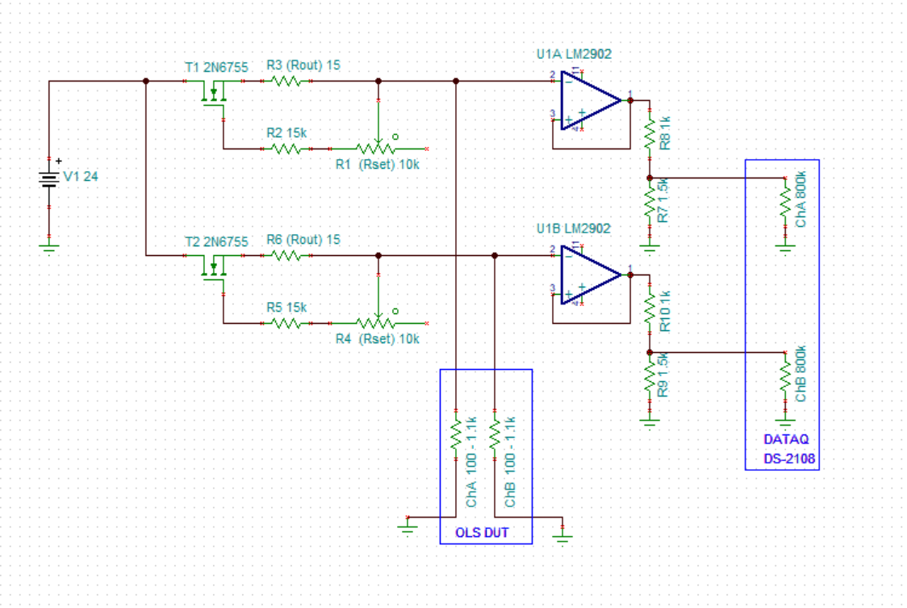
U1 LT3092
3
2
1
Current
Source
Buffer
Divider
U2 LT3092
5
3
2
7
1
6
Current
Source
Orange (white)
Buffer
Red
Divider
Yellow
Black

Slide 2
